Slide 1
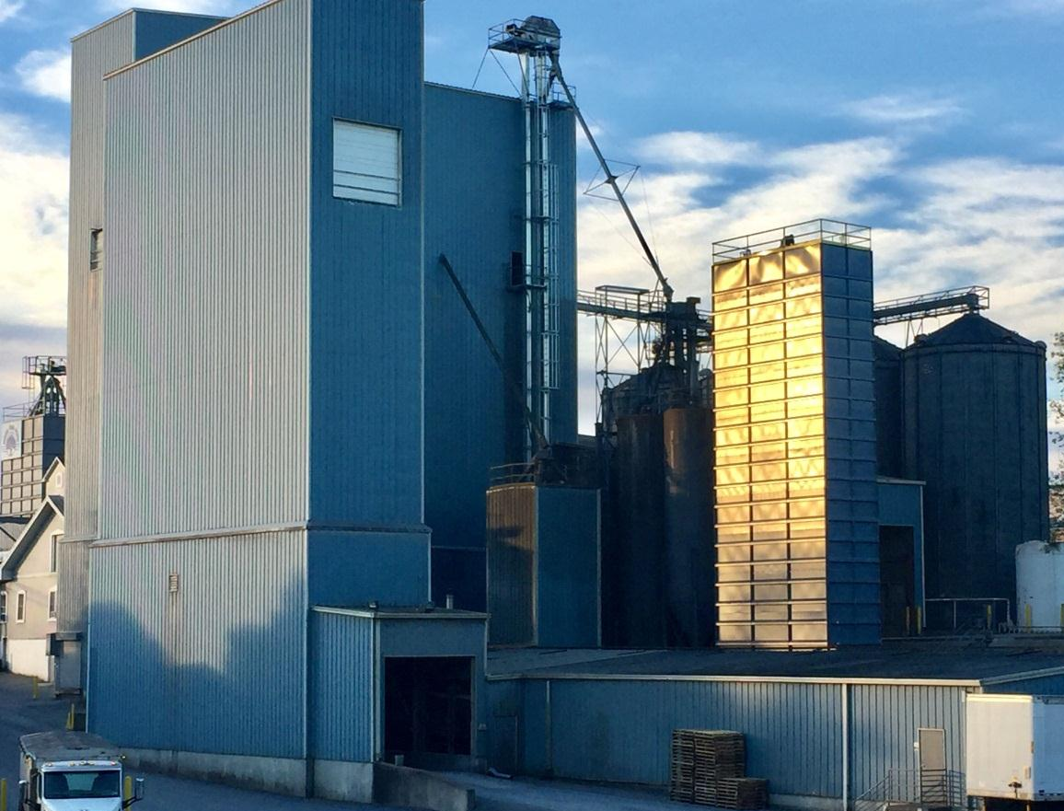

WHITE OAK & ALL AGRICULTURE ARE AN ESSENTIAL, CRITICAL INFRASTRUCTURE INDUSTRY …
As concerns surrounding COVID-19 escalate,
White Oak remains vigilant in its efforts to
continually update its protocols in accordance
with CDC, state, and local health officials to
best safeguard its employees and customers
as we continue to operate and minimize
disruptions to meet your feed needs.
We are here to serve you. Thank you for your
commitment to agriculture and doing your part
to provide Americans with a safe food supply.
Toll-Free 800.468.5524 www.whiteoakmills.com

